Slide 1
CORONA VIRUS ANALYSIS
YEAR 2021 & 2022

Slide 2
TABLE OF CONTENT
INTRODUCTION
PROBLEM STATEMENT
DATASET EXPLAINATION
DATASET OVERVIEW
DATA EXPLORATION USING SQL

Slide 3
INTRODUCTION
Coronavirus disease 2019 (COVID-19) is a contagious disease caused by the coronavirus SARS-CoV-2. The first known case was identified in Wuhan, China, in December 2019. The disease quickly spread worldwide, resulting in the COVID-19 pandemic.

Slide 4
PROBLEM STATEMENT
The CORONA VIRUS pandemic has had a significant impact on public health and has created an urgent need for data-driven insights to understand the spread of the virus. This analysis uses SQL to showcase the key insights of its spread globally in year 2020 & 2021.

Slide 5
DATASET EXPLANATION
Province: Geographic subdivision within a country/region.
Country/Region: Geographic entity where data is recorded.
Latitude: North-south position on Earth's surface.
Longitude: East-west position on Earth's surface.
Date: Recorded date of CORONA VIRUS data.
Confirmed: Number of diagnosed CORONA VIRUS cases.
Deaths: Number of CORONA VIRUS related deaths.
Recovered: Number of recovered CORONA VIRUS cases.

Slide 6
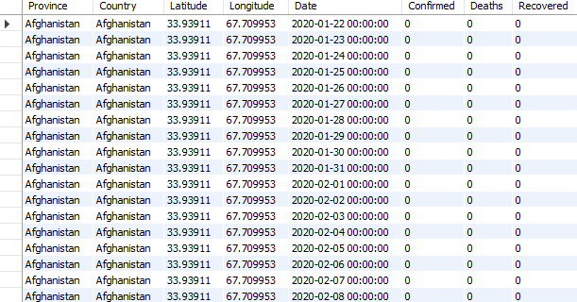
DATASET OVERVIEW

Slide 7
DATA EXPLORATION USING SQL

Slide 8
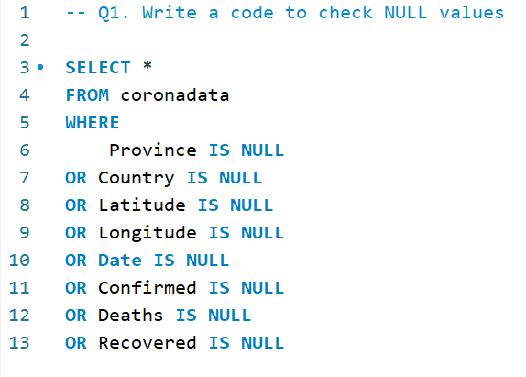

Q1. Write a code to check NULL values

Slide 9
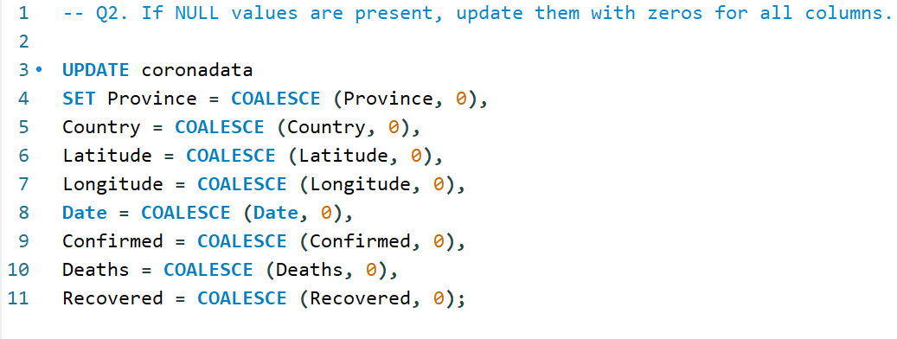
Q2. If NULL values are present, update them with zeros for all columns.

Slide 10
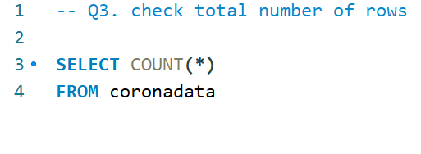

Q3. Check total number of rows

Slide 11
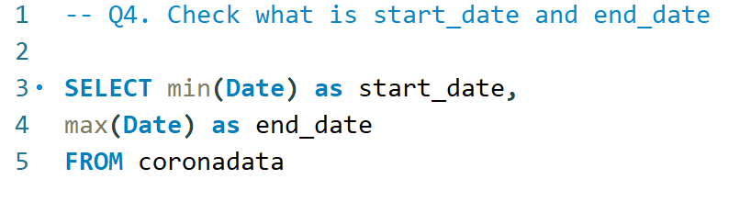
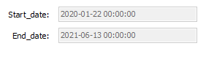
Q4. Check what is start_date and end_date

Slide 12
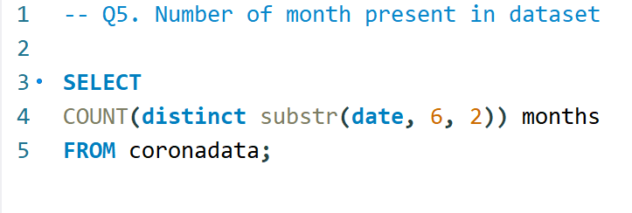

Q5. Number of month present in dataset

Slide 13
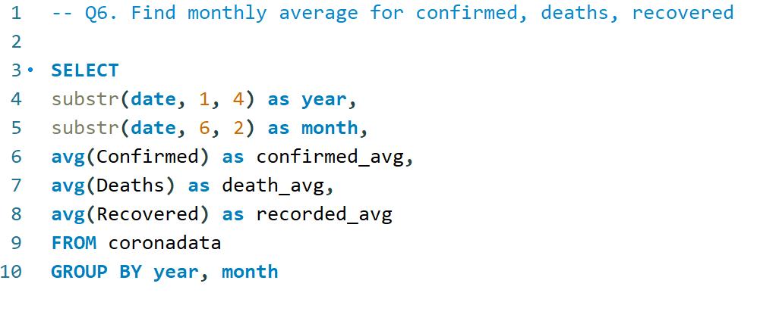
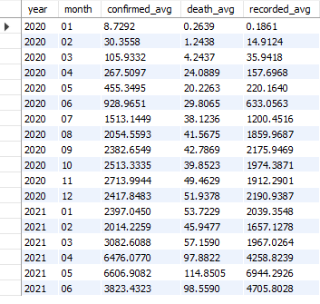
Q6. Find monthly average for confirmed, deaths, recovered

Slide 14
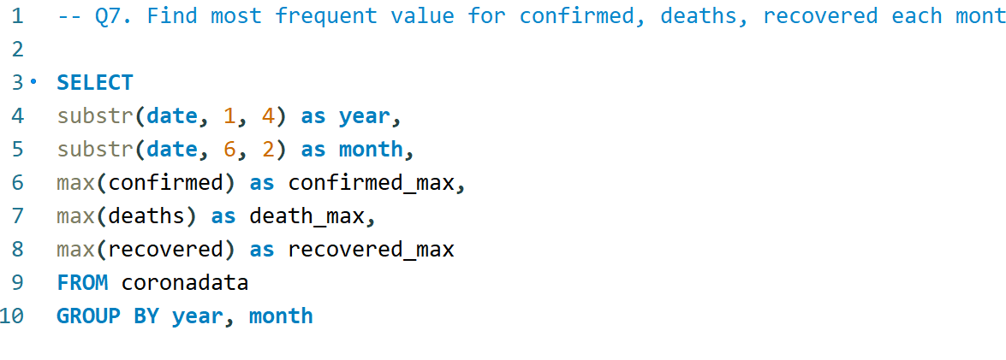
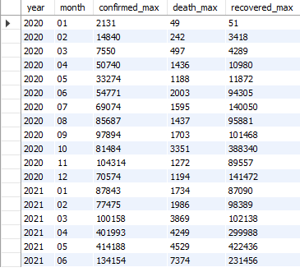
Q7. Find most frequent value for confirmed, deaths, recovered each month

Slide 15
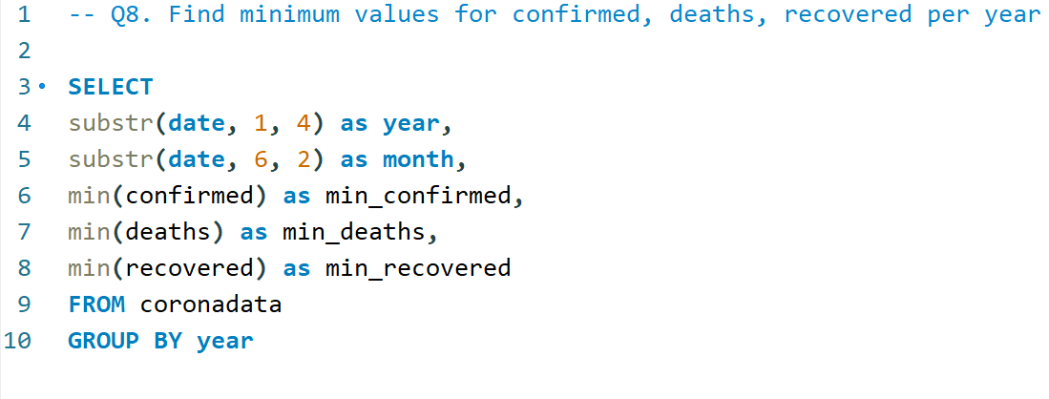

Q8. Find minimum values for confirmed, deaths, recovered per year

Slide 16
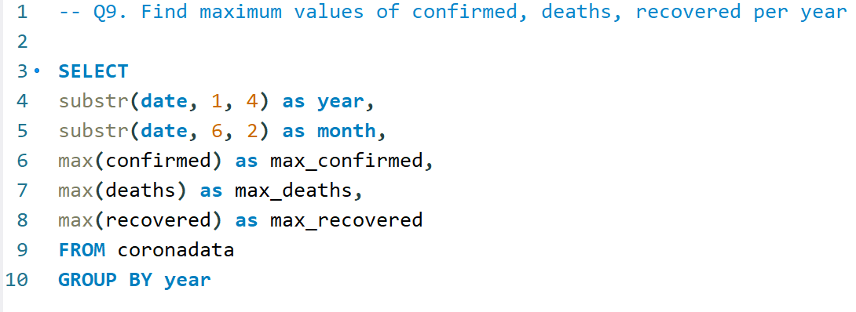

Q9. Find maximum values of confirmed, deaths, recovered per year

Slide 17
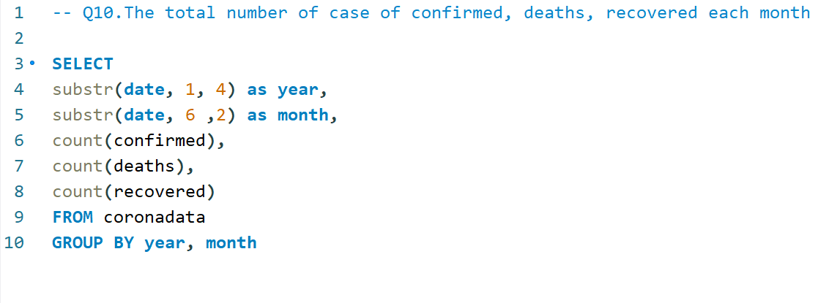
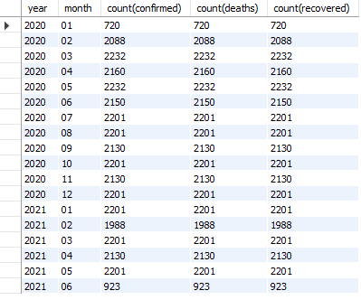
Q10. The total number of case of confirmed, deaths, recovered each month

Slide 18
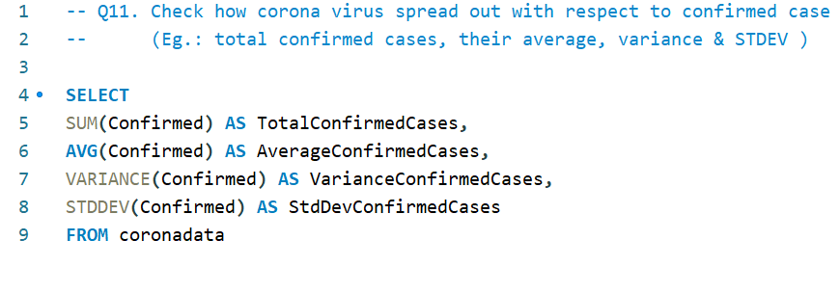
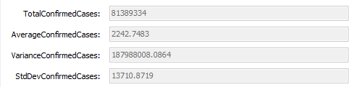
Q11. Check how corona virus spread out with respect to confirmed case (Eg.: total confirmed cases, their average, variance & STDEV )

Slide 19
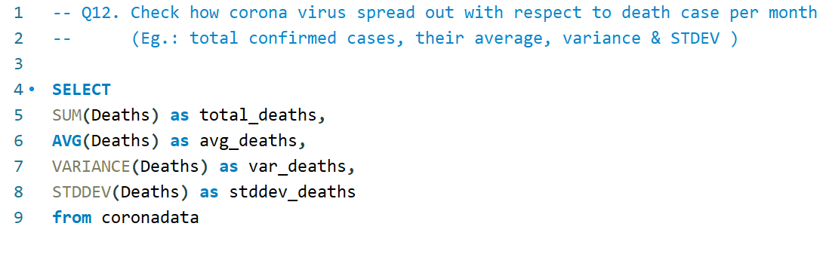
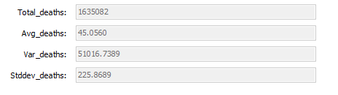
Q12. Check how corona virus spread out with respect to death case per month (Eg.: total confirmed cases, their average, variance & STDEV )

Slide 20
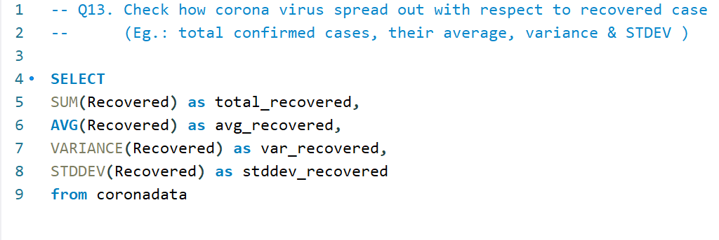
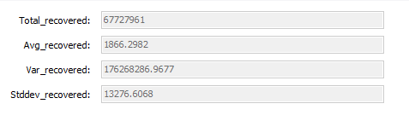
Q13. Check how corona virus spread out with respect to recovered case (Eg.: total confirmed cases, their average, variance & STDEV )

Slide 21
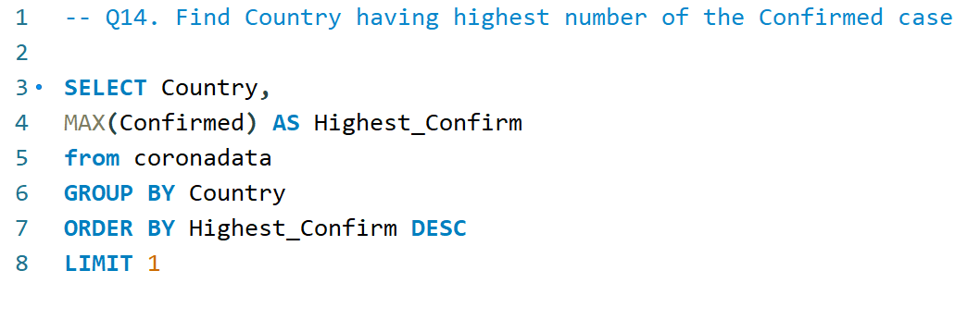
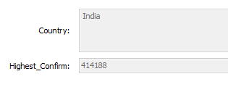
Q14. Find Country having highest number of the Confirmed case

Slide 22
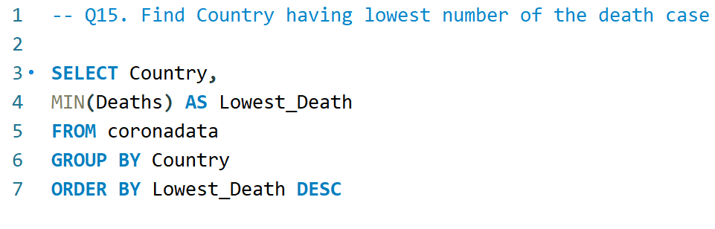
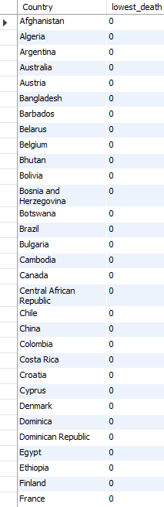
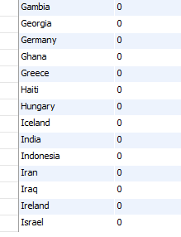
Q15. Find Country having lowest number of the death case

Slide 23
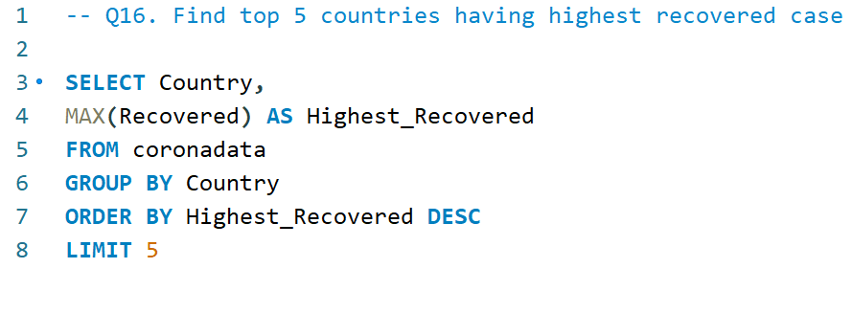
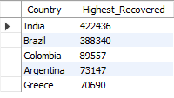
Q16. Find top 5 countries having highest recovered case

Slide 24
THANK YOU

